Slide 1
Project Scheduling
Example

Slide 2




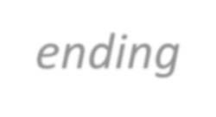
PROJECT SCHEDULING
It is part of project management within the Planning phase of
the Systems Development Life Cycle.
Project Scheduling: Allocate resources to execute all activities in the project.
Project: Set of activities or tasks with a clear beginning and ending points. The amount of available resources (time, personnel and budget) to carry out the activities is usually limited.
5

Slide 3




CPM – CRITICAL PATH METHOD
Objectives:
Establish beginning, ending and duration of each activity in the project.
Calculate overall completion time of the project given the
amount of usually limited resources.
Determine the critical path and its duration.
Determine the slack time for all non-critical activities and the whole project.
Guide the allocation of resources other than time such as staff and budget.
6

Slide 4
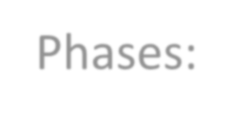

CPM – CRITICAL PATH METHOD
Phases:
Define activities or tasks according to the project objectives.
A task is an individual unit of work with a clear beginning and a clear end.
Identify precedence relationships or dependencies
Estimate time required to complete each task.
Draw an activity-on-arrow PERT diagram inserting dummy activities if required.
Apply CPM to calculate earliest and latest starting times, earliest and
latest completion times, slack times, critical path etc.
Construct a GANTT chart.
Reallocate resources and resolve if necessary.
Continuously monitor/revise the time estimates along the project
duration.
7

Slide 5
CPM – CRITICAL PATH METHOD
It is determined by adding the times for the activities in each sequence.
CPM determines the total calendar time required for the project.
If activities outside the critical path speed up or slow down (within
limits), the total project time does not change.
The amount of time that a non-critical activity can be delayed without delaying the project is called slack-time.

Slide 6
CPM – CRITICAL PATH METHOD
ES | Activity | EF
LS | Duration | LF
ES – Activity earliest start time
LS – Activity latest start time
EF – Activity earliest finishing time
LF – Activity latest finishing time
Slack Time – Maximum activity delay time
20

Slide 7
CPM – CRITICAL PATH METHOD
Step 1. Calculate ET for each node.
For each node i for which predecessors j are labelled with ES(j), ES(i) is given
by:
ES(i)= maxj [ES(j)+ t(j,i)]
where t(j,i) is the duration of task between nodes (j,i). Step 2. Calculate LT for each node.
For each node i for which successors j are labelled with LF(j), LF(i) is given
by:
LF(i)= minj [LF(j) – t(i,j)]
where t(j,i) is the duration of task between nodes (i,j).
21

Slide 8
CPM – CRITICAL PATH METHOD
Step 3. Calculate slack time for each node.
An activity with zero slack time is a critical activity and cannot be delayed without causing a delay in the whole project.
Total Float/ Slack Time: is the amount of time that an activity can be delayed from its early start date without delaying the project finish date.
Free Float: is the amount of time that an activity can be delayed without delaying the early start date of any successor activity.
21

Slide 9
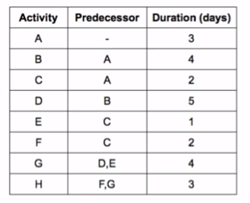
ES | Activity | EF
LS | Duration | LF

Slide 10
 | D
 | B
 | G
 | A
 | E
 | H
 | C
 | F

Slide 11
Assign Weights
 | D
 | B
 | G
 | A
 | 3
 | E
 | H
 | C
 | F

Slide 12
Assign Weights
 | D
 | B
 | 4
 | G
 | A
 | 3
 | E
 | H
 | C
 | F

Slide 13
Assign Weights
 | D
 | 5
 | B
 | 4
 | G
 | 4
 | A
 | 3
 | E
 | 1
 | H
 | 3
 | C
 | 2
 | F
 | 2

Slide 14
Calculate ES
Calculate EF
 | D
 | 5
 | B
 | 4
 | G
 | 4
0 | A | 3
 | 3
 | E
 | 1
 | H
 | 3
 | C
 | 2
 | F
 | 2

Slide 15
Calculate ES
Calculate EF
 | D
 | 5
3 | B | 7
 | 4
 | G
 | 4
0 | A | 3
 | 3
 | E
 | 1
 | H
 | 3
 | C
 | 2
 | F
 | 2

Slide 16
Calculate ES
Calculate EF
 | D
 | 5
3 | B | 7
 | 4
 | G
 | 4
0 | A | 3
 | 3
 | E
 | 1
 | H
 | 3
3 | C | 5
 | 2
 | F
 | 2

Slide 17
Calculate ES
Calculate EF
7 | D | 12
 | 5
3 | B | 7
 | 4
 | G
 | 4
0 | A | 3
 | 3
 | E
 | 1
 | H
 | 3
3 | C | 5
 | 2
 | F
 | 2

Slide 18
Calculate ES
Calculate EF
7 | D | 12
 | 5
3 | B | 7
 | 4
 | G
 | 4
0 | A | 3
 | 3
5 | E | 6
 | 1
 | H
 | 3
3 | C | 5
 | 2
 | F
 | 2

Slide 19
Calculate ES
Calculate EF
7 | D | 12
 | 5
3 | B | 7
 | 4
12
6
}
max
12 | G | 16
 | 4
0 | A | 3
 | 3
5 | E | 6
 | 1
 | H
 | 3
3 | C | 5
 | 2
 | F
 | 2

Slide 20
Calculate ES
Calculate EF
7 | D | 12
 | 5
3 | B | 7
 | 4
12 | G | 16
 | 4
0 | A | 3
 | 3
5 | E | 6
 | 1
16 | H | 19
 | 3
3 | C | 5
 | 2
5 | F | 7
 | 2

Slide 21
Calculate LS
Calculate LF
7 | D | 12
 | 5
3 | B | 7
 | 4
12 | G | 16
 | 4
0 | A | 3
 | 3
5 | E | 6
 | 1
16 | H | 19
16 | 3 | 19
3 | C | 5
 | 2
5 | F | 7
 | 2

Slide 22
Calculate LS
Calculate LF
7 | D | 12
 | 5
3 | B | 7
 | 4
12 | G | 16
 | 4 | 16
0 | A | 3
 | 3
5 | E | 6
 | 1
16 | H | 19
16 | 3 | 19
3 | C | 5
 | 2
5 | F | 7
 | 2 | 16

Slide 23
Calculate LS
Calculate LF
7 | D | 12
 | 5
3 | B | 7
 | 4
12 | G | 16
12 | 4 | 16
0 | A | 3
 | 3
5 | E | 6
 | 1
16 | H | 19
16 | 3 | 19
3 | C | 5
 | 2
5 | F | 7
14 | 2 | 16

Slide 24
Calculate LS
Calculate LF
7 | D | 12
 | 5
3 | B | 7
 | 4
12 | G | 16
12 | 4 | 16
0 | A | 3
 | 3
5 | E | 6
11 | 1 | 12
16 | H | 19
16 | 3 | 19
3 | C | 5
 | 2
5 | F | 7
14 | 2 | 16

Slide 25
Calculate LS
Calculate LF
7 | D | 12
 | 5
3 | B | 7
 | 4
12 | G | 16
12 | 4 | 16
0 | A | 3
 | 3
5 | E | 6
11 | 1 | 12
16 | H | 19
16 | 3 | 19
3 | C | 5
9 | 2 | 11
5 | F | 7
14 | 2 | 16
11
14
}
min

Slide 26
Calculate LS
Calculate LF
7 | D | 12
7 | 5 | 12
3 | B | 7
3 | 4 | 7
12 | G | 16
12 | 4 | 16
0 | A | 3
0 | 3 | 3
5 | E | 6
11 | 1 | 12
16 | H | 19
16 | 3 | 19
3 | C | 5
9 | 2 | 11
5 | F | 7
14 | 2 | 16

Slide 27
Critical Path
7 | D | 12
7 | 5 | 12
3 | B | 7
3 | 4 | 7
12 | G | 16
12 | 4 | 16
0 | A | 3
0 | 3 | 3
5 | E | 6
11 | 1 | 12
16 | H | 19
16 | 3 | 19
3 | C | 5
9 | 2 | 11
5 | F | 7
14 | 2 | 16

Slide 28
Total Float (TF)/Slack
TF=LF-EF (Finish Float)
TF=LS-ES (Start Float)
7 | D | 12
7 | 5 | 12
3 | B | 7
3 | 4 | 7
12 | G | 16
12 | 4 | 16
0 | A | 3
0 | 3 | 3
5 | E | 6
11 | 1 | 12
16 | H | 19
16 | 3 | 19
3 | C | 5
9 | 2 | 11
5 | F | 7
14 | 2 | 16

Slide 29
Total Float (TF) /Slack
TF=LF-EF (Finish Float)
TF=LS-ES (Start Float)
7 | D | 12
7 | 5 | 12
3 | B | 7
3 | 4 | 7
0
12 | G | 16
12 | 4 | 16
0 | A | 3
0 | 3 | 3
5 | E | 6
11 | 1 | 12
16 | H | 19
16 | 3 | 19
3 | C | 5
9 | 2 | 11
5 | F | 7
14 | 2 | 16

Slide 30
Total Float (TF) /Slack
TF=LF-EF (Finish Float)
TF=LS-ES (Start Float)
0
7 | D | 12
7 | 5 | 12
3 | B | 7
3 | 4 | 7
0
12 | G | 16
12 | 4 | 16
0 | A | 3
0 | 3 | 3
5 | E | 6
11 | 1 | 12
16 | H | 19
16 | 3 | 19
3 | C | 5
9 | 2 | 11
5 | F | 7
14 | 2 | 16

Slide 31
Total Float (TF) /Slack
TF=LF-EF (Finish Float)
TF=LS-ES (Start Float)
0
0
7 | D | 12
7 | 5 | 12
3 | B | 7
3 | 4 | 7
0
0
6
12 | G | 16
12 | 4 | 16
0 | A | 3
0 | 3 | 3
5 | E | 6
11 | 1 | 12
0
6
16 | H | 19
16 | 3 | 19
9
3 | C | 5
9 | 2 | 11
5 | F | 7
14 | 2 | 16

Slide 32
Free Float (FF)
FF=Min(of ES of Successors)-ES(Activity)-Duration(Activity)
0
0
7 | D | 12
7 | 5 | 12
3 | B | 7
3 | 4 | 7
0
0
6
12 | G | 16
12 | 4 | 16
0 | A | 3
0 | 3 | 3
5 | E | 6
11 | 1 | 12
0
6
16 | H | 19
16 | 3 | 19
9
3 | C | 5
9 | 2 | 11
5 | F | 7
14 | 2 | 16

Slide 33
Free Float (FF)
FF=Min(of ES of Successors)-ES(Activity)-Duration(Activity)
=3-0-3
=0
0
0
7 | D | 12
7 | 5 | 12
3 | B | 7
3 | 4 | 7
0
0
6
12 | G | 16
12 | 4 | 16
0 | A | 3
0 | 3 | 3
5 | E | 6
11 | 1 | 12
0
0
16 | H | 19
16 | 3 | 19
6
9
3 | C | 5
9 | 2 | 11
5 | F | 7
14 | 2 | 16

Slide 34
Free Float (FF)
FF=Min(of ES of Successors)-ES(Activity)-Duration(Activity)
=5-3-2
=0
0
0
7 | D | 12
7 | 5 | 12
3 | B | 7
3 | 4 | 7
0
0
6
12 | G | 16
12 | 4 | 16
0 | A | 3
0 | 3 | 3
5 | E | 6
11 | 1 | 12
0
0
16 | H | 19
16 | 3 | 19
6
9
3 | C | 5
9 | 2 | 11
5 | F | 7
14 | 2 | 16
0

Slide 35
Free Float (FF)
FF=Min(of ES of Successors)-ES(Activity)-Duration(Activity)
=5-3-2
=0
0
0
7 | D | 12
7 | 5 | 12
3 | B | 7
3 | 4 | 7
0
0
0
0
6
12 | G | 16
12 | 4 | 16
0 | A | 3
0 | 3 | 3
5 | E | 6
11 | 1 | 12
0
0
0
16 | H | 19
16 | 3 | 19
6
6
9
3 | C | 5
9 | 2 | 11
5 | F | 7
14 | 2 | 16
0
0
9

Slide 36
GANTT CHART
A GANTT chart is a type of bar chart that illustrates a project
schedule.
After the PERT/CPM analysis is completed, the following phase is to construct the GANTT chart and then to re- allocate resources and re-schedule if necessary.
GANTT charts have become a common technique for representing the phases and activities of a project work breakdown structure.
It was introduced by Henry Gantt around 1910 – 1915.

Slide 37
GANTT CHART
Characteristics:
The bar in each row identifies the corresponding task
The horizontal position of the bar identifies start and end times of the task
Bar length represents the duration of the task
Task durations can be compared easily
Good for allocating resources and re-scheduling
Precedence relationships can be represented using arrows
Critical activities are usually highlighted
Slack times are represented using bars with doted lines
The bar of each activity begins at the activity earliest start time (ES)

The bar of each activity ends at the activity latest finish time (LF).
45

Slide 38
GANTT CHART
Advantages
Simple
Good visual communication to others
Task durations can be compared easily
Good for scheduling resources
Disadvantages
Dependencies are more difficult to visualise
Minor changes in data can cause major changes in the chart

Slide 39
CONSTRUCTING GANTT CHART
The steps to construct a GANTT chart from the information
obtained by PERT CHART and CPM are:
Schedule the critical tasks in the correct position.
Place the time windows in which the non-critical tasks can
be scheduled.
Schedule the non-critical tasks according to their earliest starting times.
Indicate precedence relationships between tasks.

Slide 40
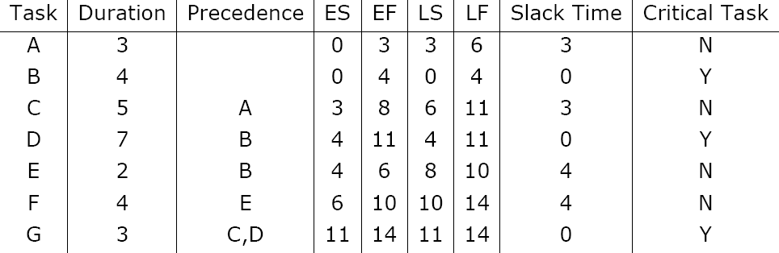
CONSTRUCTING GANTT CHART
Example of an early GANTT chart construction:

Slide 41
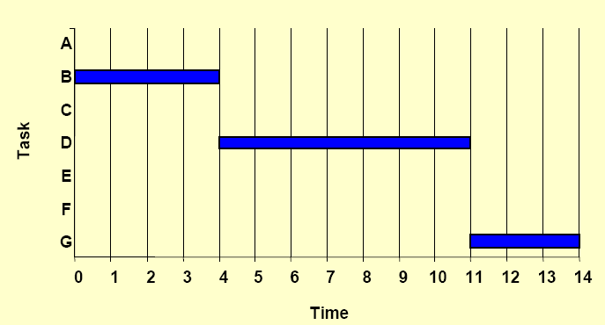
CONSTRUCTING GANTT CHART
Step 1. Schedule critical tasks:

Slide 42
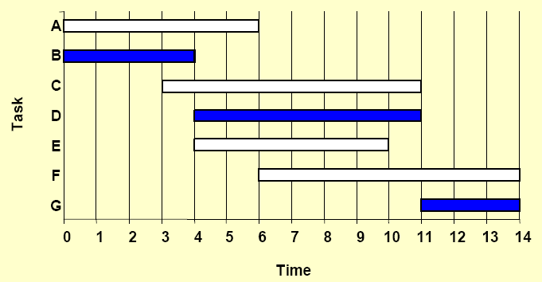
CONSTRUCTING GANTT CHART
Step 2. Place time windows for non-critical tasks:

Slide 43
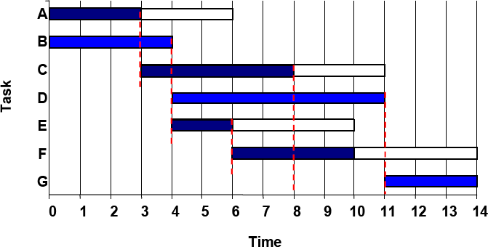
CONSTRUCTING GANTT CHART
Step 3. Schedule non-critical tasks
Step 4. Indicate precedence relationships:

Slide 44
STAFFING & RE-SCHEDULING
Once the project schedule, (e.g. GANTT chart), has been
constructed, take into account
available staff hours
slack times and
the project schedule
Assign staff and other resources to each activity in the project

Slide 45


STAFFING & RE-SCHEDULING
Resource Smoothing is a technique used to re-allocate
resources and re-schedule activities.
In resource smoothing, non-critical tasks are re-scheduled within their time window.
Staff Utilization:(duration of activity x staff required for each activity, all added together) / (maximum staff required x duration of project)

Slide 46

STAFFING & RE-SCHEDULING
Example1

Slide 47
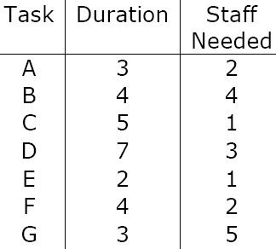
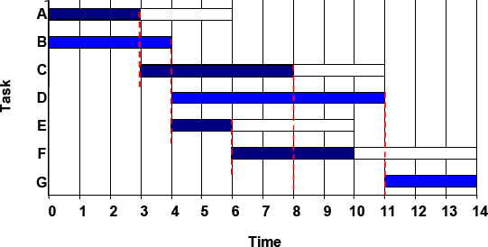
STAFFING & RE-SCHEDULING
The original schedule (constructed above) for this project is as shown below.
1. Staff utilisation = (3x2+4x4+5x1+7x3+2x1+4x2+3x5)/(14x6) = 0.857 = 85.5%

Slide 48
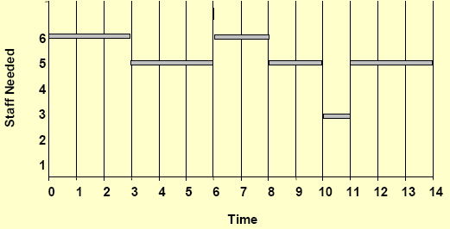
STAFFING & RE-SCHEDULING
2. Work out the Staff Profile

Slide 49
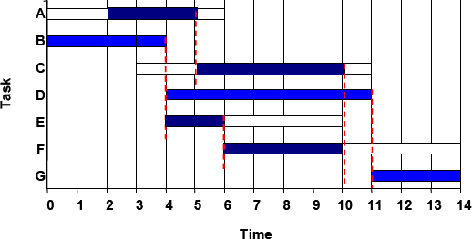
STAFFING & RE-SCHEDULING
Now, assume that there are 6 people available for working in this project but one of them returns from holidays at time=2.
So re-scheduling is needed because activities A and B cannot be carried out in parallel until time=2.

Slide 50
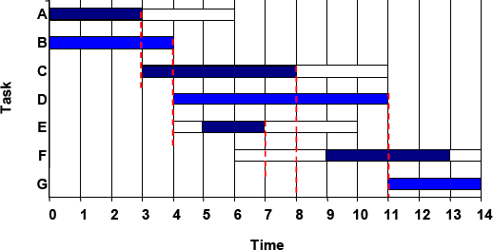
STAFFING & RE-SCHEDULING
Suppose another scenario in which equipment and materials needed to carry out activities E and F are available at time=5 and time=9 respectively instead of being available at the activities ES time. Then, rescheduling is needed but the overall duration of the project is not affected.

